Slide 1
Biomimicry Duets Book

Slide 2
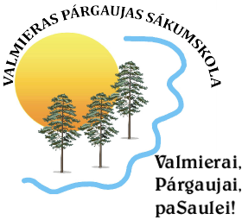
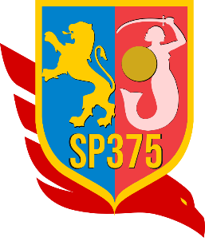
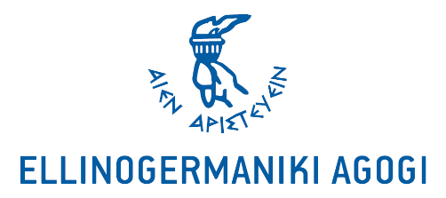
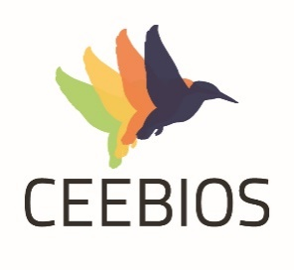
Hello, nice to meet you!

Slide 3
I am your personal guide into the biomimicry world and I want to invite you for a biomimicry adventure!
We will discover together how extraordinary nature - plants, animals, the landscape, and other features and products of the earth, can be.
You can glue your Biomimicry Duets cards here and read a bit more about animals and inventions inspired by them. There is also a space designed only for you, which you can use to create your own Biomimicry Duet.
- Your Biomimcry Duets Book
InNature Biomimicry Duets Book and Cards are part of IO3 InNature Fair – 3 days of biomimicry activities at schools to share experiences and have fun, instigating the interest of the school community on the topic.
This project has been funded with support from the European Commission. This publication reflects the views only of the author, and the Commission cannot be held responsible for any use which may be made of the information contained therein. Project Nº. 2019-1-PL01-KA201-065655

Slide 4
GLUE THE CARD HERE (1A)
GLUE YOUR CARD HERE (B)
Coral takes in minerals and CO2 and then secretes calcium carbonate to build its hard exoskeleton. When corals anchor themselves, they do so as attached polyps in large colonies, and they do it by using calcium carbonate, or lime, as a cement.
The Great Barrier Reef along Australia's north-eastern coast is a huge collection of these colonies, built on the 10,000- year old ruins of their ancestors' exoskeletons. Their method for building their homes is worlds away from the way humans have been making cement and concrete.

Slide 5
GLUE YOUR CARD HERE (A)
GLUE THE CARD HERE (1B)
Traditional cement is manufactured by heating a precise mixture of finely ground limestone, clay and sand in a rotating kiln to temperatures reaching 1450ºC, and as a result, cement production is a significant source of global CO2 emissions, making up approximately 2.4 percent of global CO2 emissions from industrial and energy sources.
Carbon neutral cement production develops a way to capture CO2 and dissolve it in seawater to form calcium carbonate, which
has properties suitable for use in construction and could replace Portland cement.

Slide 6
GLUE THE CARD HERE (2A)
GLUE THE CARD HERE (6B)
There are almost 20,000 butterfly species. The average life of an adult butterfly is three to four weeks, however, the entire life cycle can last anywhere between two and eight months. They only eat liquids - using their proboscis, which functions in the same way as a straw, butterflies drink nectar and other liquids.
Despite how they may appear in motion, or in drawings or paintings you may have seen, butterflies have four separate wings. The wings of the rose butterfly are built from tiny scales that are covered in randomly spaced holes. The holes are less than a millionth of a meter wide, and they help scatter the light and help the butterfly absorb heat.
The Pangolin bag concept puts ethics and ecology at the centre of its core values. It is inspired by biomimetic and it’s eco-friendly, as it’s largely made of recycled rubber for a long-lasting effect and durability.
The Pangolin backpack line rejects traditional backpack zippers to access the bag’s contents. The backpack storage space is created by layers that overlap. This creates a durable and flexible bag for transport that allows the user to access the contents with ease when needed. The fastened exterior shell is secured with strong magnets. This function mimics a pangolin’s ability to recoil itself.

Slide 7
GLUE THE CARD HERE (6A)
GLUE THE CARD HERE (2B)
All eight pangolin species are protected under national and international laws, and two are listed as Critically Endangered on the IUCN Red List of Threatened Species.
Their name comes from ‘penggulung,’ the Malay word for roller – the action a pangolin takes in self-defense. A startled pangolin will cover its head with its front legs, exposing its scales to any potential predator. If touched or grabbed it will roll up completely into a ball, while the sharp scales on the tail can be used to lash out.
Solar power is energy from the sun that is converted into thermal or electrical energy. Solar energy is the cleanest and most abundant renewable energy source available. Solar technologies can harness this energy for a variety of uses, including generating electricity, providing light or a comfortable interior environment, and heating water.
Most solar panels are positioned at an angle, which means they generate lots of power for a few hours and then not much the rest of the time. Solar panels using Siddique’s technique could produce more power throughout the day.

Slide 8
GLUE THE CARD HERE (3A)
GLUE THE CARD HERE (5B)
An outdoor cat is active both day and night, although it tend to be slightly more active at dawn and dusk, as it is a solitary hunter but a social species. It can hear sounds too faint or too high in frequency for human ears, such as those made by mice and other small mammals.
Cats can't see fine detail or rich colours, but have a superior ability to see in the dark because of the high number of rods and a tapetum lucidum in theirs eyes, which reflects any light that passes through the retina back into the eye, thereby increasing the eye's sensitivity to dim light. As a result, cats can see using roughly one-sixth the amount light that people need.
That device allowed a 70kg man to scale a glass wall like Spider-Man. The hand-sized silicone pads created by a team at Stanford University keep their adhesive strength at all sizes.
Pads employ the same attractive and repulsive forces between molecules (a group of two or more atoms that form the smallest identifiable unit into which a pure substance can be divided and still retain the composition and chemical properties of that substance), that geckos use. Although the forces are very weak, the effect is multiplied across the many tiny hairs that cover the toes of a gecko, allowing them to stick firmly to surfaces.

Slide 9
GLUE THE CARD HERE (5A)
GLUE THE CARD HERE (3B)
There are more than 1,100 species of geckos. There are geckos without legs, geckos measuring 1,6 cm, gliding in air geckos, etc.
Geckos' toes allow them to stick to any surface except teflon. They cling with incredible ease thanks to nanoscale hairs, known as setae, that line every toe in huge numbers.
They use their tails to store fat and nutrients for lean times.
They are able to drop their tails and regrow them. When a gecko is grabbed, the tail drops off and continues to twitch and thrash about, providing a great distraction that might allow the gecko to escape from a hungry predator.
English inventor Percy Shaw created many gadgets, but he’s most widely recognized for his contribution to road safety: the cat’s eye. He developed this reflective road stud to help driver’s follow the road in the dark or fog.
The device used glass encased in rubber and metal to precisely reflect light rays from vehicle headlamps back at the driver. Over time, the stud was simplified and refined into a rubber block with abrasion- resistant glass.

Slide 10
GLUE THE CARD HERE (4A)
GLUE THE CARD HERE (4B)
Mosquitoes have been around since the Jurassic period. That makes them about 210 million years old. Only females bite. The female needs blood to help her eggs develop. Both male and female feed mainly on fruit and plant nectar. The average mosquito lives less than two months. Males live 10 days or less while females can live up to eight weeks. Mosquitoes can hibernate. At temperatures less than 50 degrees, they shut down. Females that hibernate may live up to six months.
Mosquitos are drawn to humans by their breath, sweat and body heat - they detect the CO2 released when we exhale, as well as body warmth. They are drawn to people drinking beer.
The researchers are in favour of a double needle. One needle pierces the skin and administers the drug or draws blood, the other administers a light anaesthetic. Like the mosquito’s proboscis, the first needle is softer at the tip, while the outside immediately surrounding it is serrated. It pierces the skin using a vibrating action.
The next step now is to actually make the needle according to this design. The objectives are reduced pain for injecting or drawing blood samples or to make very small biomedical devices, that for instance are used in diabetic patients to monitor blood- glucose levels.

