Slide 1
CORAL
TYPE | Underwater ecosystem
SUPER POWER | - less than 0.1% of the world's ocean area - home for at least 25% of all marine species
A coral reef is composed of thousands of soft-bodied animals called coral polyps that collect layers of calcium carbonate over time. They are crucial to the survival of life on Earth.
BIOMIMICRY DUETS 1A

Slide 2
CARBON NEUTRAL CEMENT
YEAR OF DISCOVERY | XXI century, around 2020
SUPER POWER | captures CO2 emissions durable building material
The first full-scale installation for carbon capture was built at the Brevik cement plant, in Norway. Up to 1.8 million tonnes of carbon dioxide are to be captured annually from 2030 onwards, which will be crucial for the environment.
BIOMIMICRY DUETS 1B

Slide 3
ROSE BUTTERFLY
TYPE | Insect
SUPER POWER | - black wings absorb energy
The rose butterfly is native to Southeast Asia and its wings are built from tiny scales that are covered in spaced holes. Butterflies are indicators of a healthy environment and ecosystems and they pollinate plants in gardens.
BIOMIMICRY DUETS 2A

Slide 4
SOLAR PANELS (Siddique’s technique)
YEAR OF DISCOVERY | Roots of solar power 1839, Siddique’s technique around 2016
SUPER POWER | - produce more power throughout the whole day, not only during a few hours
Siddiques’s cells can absorb a lot of light regardless of the sun’s angle. Solar technologies convert sunlight into electrical energy and are environment-friendly.
BIOMIMICRY DUETS 2B

Slide 5
CAT
TYPE | Carnivorous Mammal
SUPER POWER | strong flexible body quick reflexes sharp teeth and retractable claws well developed night vision and sense of smell
Cats can jump up to 6 times their height and run up to 30mph. 1 year of their life equals to 15 years of a humans live. They sleep for around 13 to 16 hours a day (70% of their life).
BIOMIMICRY DUETS 3A

Slide 6
ROAD STUDS
YEAR OF DISCOVERY | Around 1934
SUPER POWER | - it helps drivers’ follow the road in the dark or fog.
Road studs come in different sizes and are available in aluminum, rigid ABS plastic or glass. They are built to be able to withstand heavy loads and severe impacts.
BIOMIMICRY DUETS 3B

Slide 7
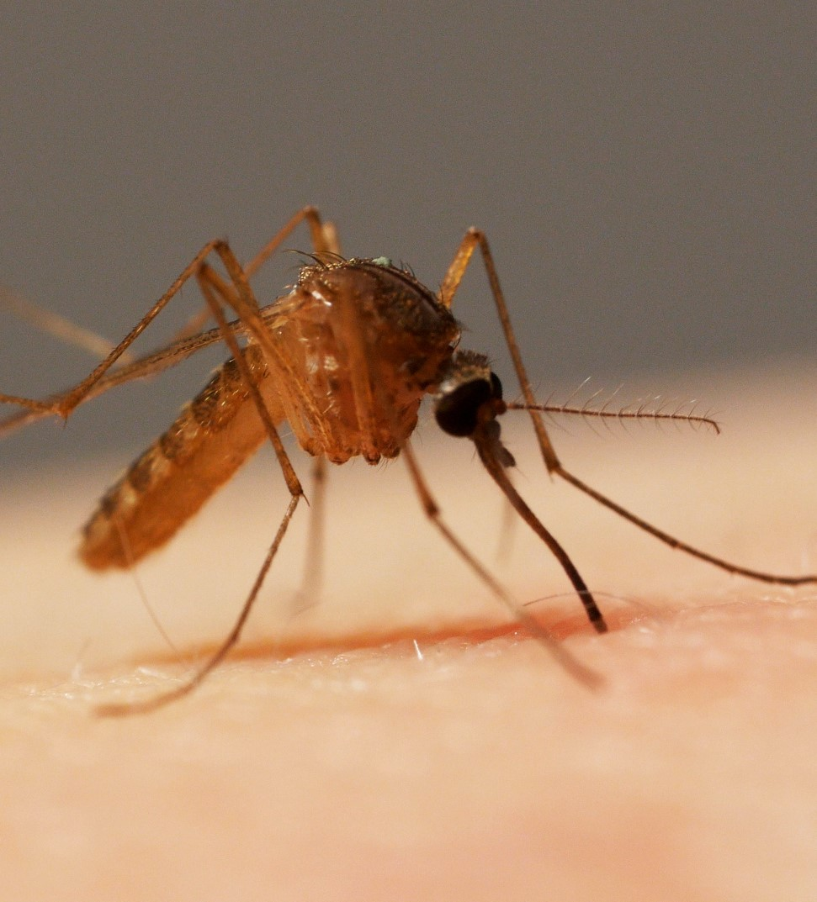
MOSQUITO
TYPE | Insect
SUPER POWER | - Penetrating human skin painlessly
The mosquito uses the 2 maxillae as variable frequency microsaws with nanosharp teeth to advance into the skin. This enables the mosquito to insert its feeding fascicle into human skin using an exceedingly small force.
BIOMIMICRY DUETS 4A

Slide 8
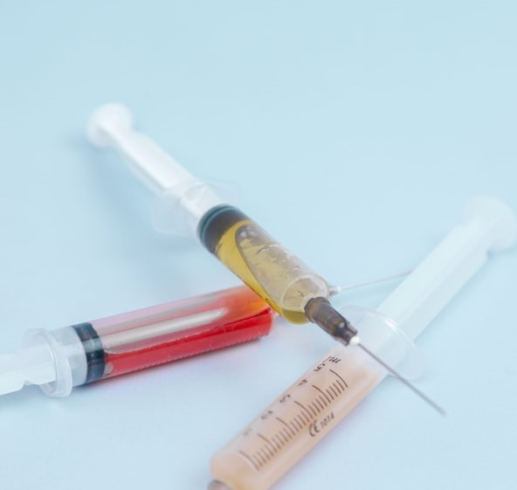
MICRONEEDLE
YEAR OF DISCOVERY | 2018
SUPER POWER | - Penetrating human skin painlessly
Researchers developed 2 needles. One pierces the skin and administers the drug or draws blood, the other administers a light anesthetic. Like the mosquito’s proboscis, the first needle is softer at the tip, while the outside surrounding is serrated.
BIOMIMICRY DUETS 4B

Slide 9
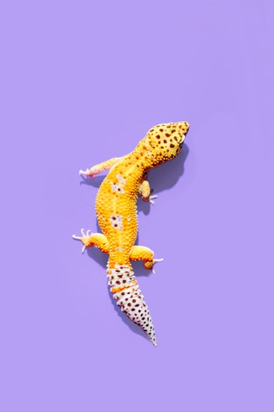
GECKO
TYPE | Reptile
SUPER POWER | - climb vertical walls due to the tiny hair-like strands on the bottom of their feet
Geckos are a type of lizard found on every continent except Antarctica, and live in almost every habitat, including rain forests, deserts and mountains.
BIOMIMICRY DUETS 5A

Slide 10
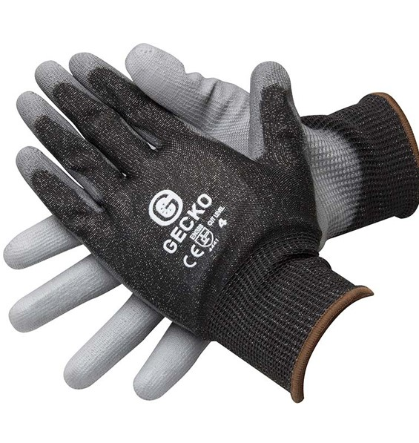
CLIMBING GLOVES
YEAR OF DISCOVERY | 2014
SUPER POWER | - humans can climb glass walls easily with these gloves
The gecko glove is a pad of 24 tiles covered in a synthetic adhesive that shares large loads—like the weight of a human body—across all tiles evenly.
BIOMIMICRY DUETS 5B

Slide 11
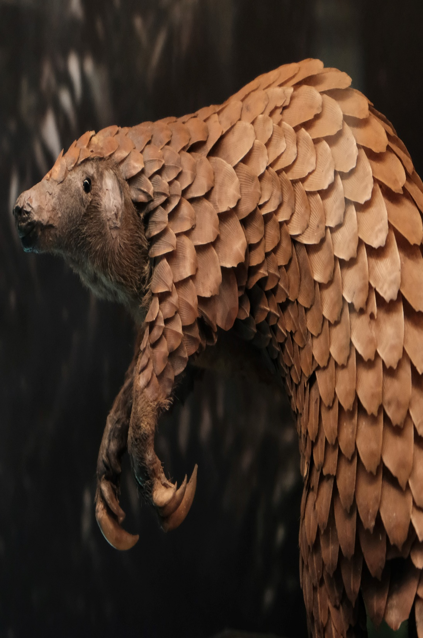
PANGOLIN
TYPE | Mammal
SUPER POWER | under threat, it curls into a tight ball it uses their sharp-scaled tails as defense
Though many think of them as reptiles, pangolins are mammals. They are the only mammals wholly-covered in scales and they use those scales to protect themselves from predators.
BIOMIMICRY DUETS 6A

Slide 12
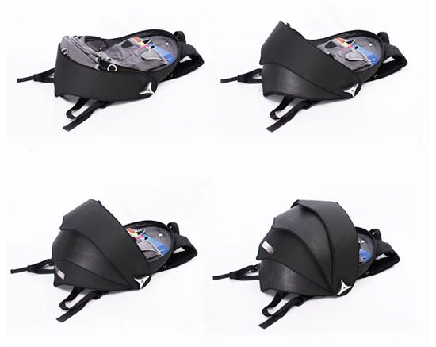
PANGOLIN BACKPACK
YEAR OF DISCOVERY | 2010
SUPER POWER | durable and flexible easy access to the contents
The design is arranged so the pieces retract onto one another rather than a standard zipper enclosure. The design mimics the razor-sharp scales on the back of the spiny pangolin.
BIOMIMICRY DUETS 6B

