Slide 1
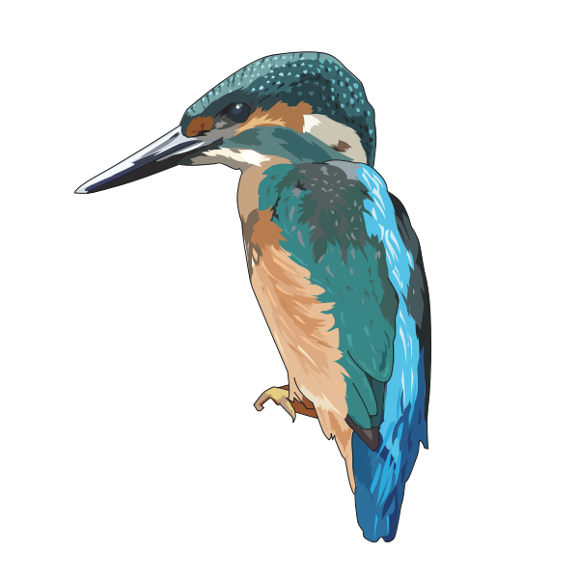
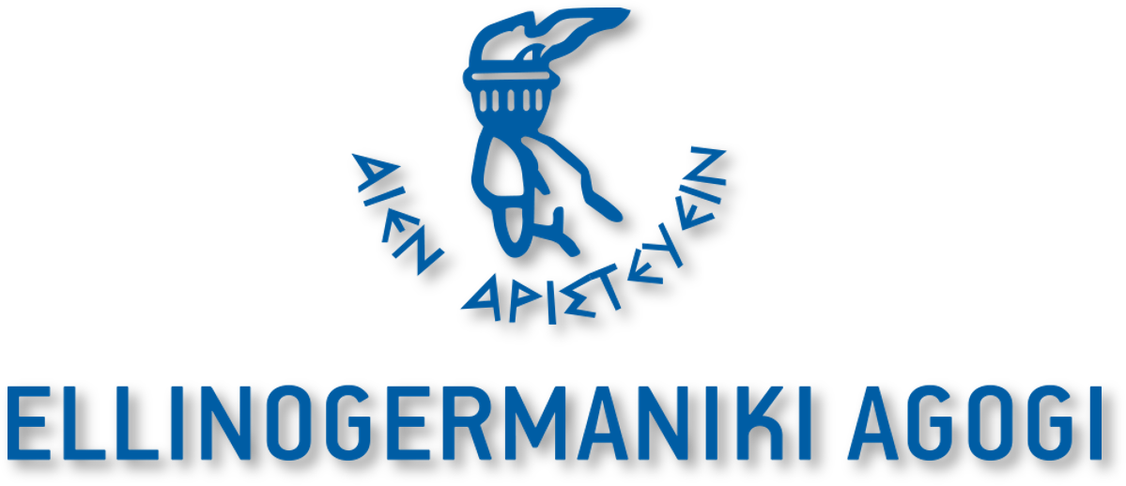
Biomimicry Card Game

Slide 2
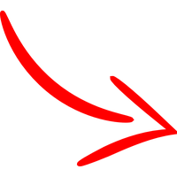
HOW TO PLAY?
Number of Players: 2 – 5
Edition Year: 2021
Duration: 5' - 25'
Ages: 5 - 99 years old
Number of cards (Total): 33
Game cards: 30
Special cards: 2
Rules cards: 1
Welcome to the Biomimicry Cards Game!
Playing with the cards, you will get introduced to different Biomimicry Prototypes inspired by Nature. Before you begin, feel free to search for what Biomimicry is, why Biomimicry and Nature-based solutions are of paramount importance for our lives and how Biomimicry is related to Sustainable Development Goals! Why, how and when a prototype is sustainable? Keep in mind when you read about Biomimicry prototypes the "Ten principles of Biomimicry" which are based on:
the energy consumption,
recyclable materials used,
cooperation of different nature's functions,
optimizing rather than maximizing in terms of efficiency,
materials used and
shared information.
All Biomimicry examples you see here are characterized based on these principles. However, do not forget that it is just a game so, the gradings of these prototypes are just indicative! What you have to keep in mind? That all these concepts were inspired by students, researchers and scientists…like you!

Slide 3
Biomimicry Card game rules (1 – 4 players):
Aim of the game: Be the first player to win all the cards.
Shuffle: Shuffle the cards and give each player an equal number of cards. All the remaining cards are removed.
Don’t look or cheat: Players must keep all their cards in a pile (without seeing what they have) and only look at the top card.
Stat: Player 1 (on the left of the player who dealt the cards) starts the game by reading out the stat from their card they think is highest.
Special cards: Whoever has the red card, receives 2 cards from each player while with the yellow card receives 1 card from each player.
Highest wins: The player with highest stat takes the losing card(s) and places them at the bottom of their pile.
Can you trump it?: Other players then look at their top card and see if the same stat category can be beaten.
Battle draw: If 2 cards have the same attribute value then they all remain down and they are won by the winner of the next round.
Winner!: The player with all the cards at the end, wins!
Scan the QR codes!: Learn more about the Biomimicry concepts by scanning the QR codes on the backside of the cards.
Create your own Biomimicry cards!: Having the digital template, you can modify the cards as you will. Find relevant Biomimicry examples or get inspired by Nature to create your own prototypes and cards!
Special edition (5 players):
Remove the special cards. All remaining cards are dealt equally. Each card in the top left corner has a letter and a number (A1, B2, etc.). The aim is to collect the most sets of five cards of the same colour (e.g. A1-A5). The first player asks a player for the card needed for to make a set of five. If the player answers that he has the requested card, they battle and continues to ask for cards from other players until someone tells him that he does not have the requested card. Then the player who answered no continues, asking for a card from another player of his choice. IMPORTANT: Set a time limit, for example 10 minutes of play. At the end of the time, the winner is the player with the most sets of five cards.

Slide 4
GET 1 CARD FROM EACH PLAYER!

Slide 5
GET 2 CARDS FROM EACH PLAYER!!

Slide 6
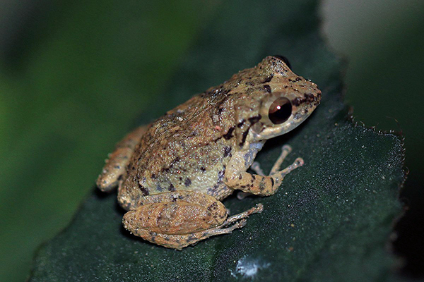
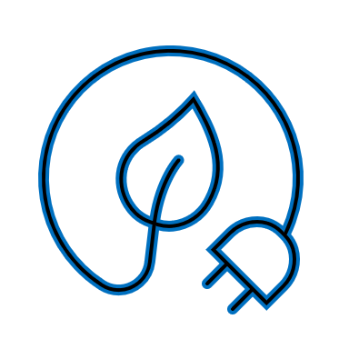
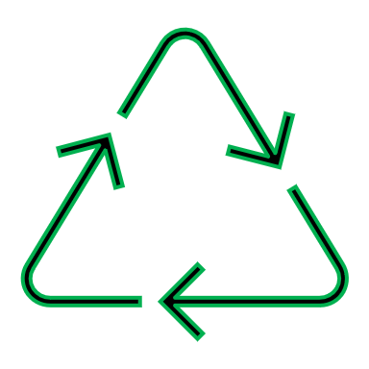
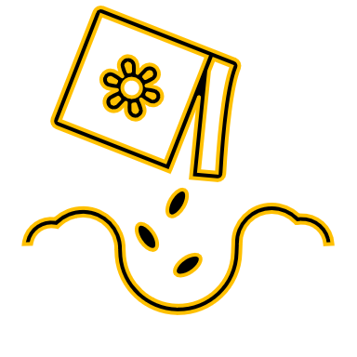
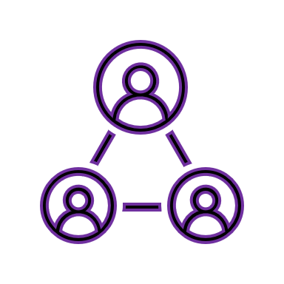
A1.Hydro-Canopy Facade System
The HydroCanopy offers a low-cost, high-efficiency architectural façade system solution that responds to climatic conditions using passive control strategies that regulate solar radiation, ventilation, thermal inertia, and offers an evaporative cooling system.
Energy
10/10
Optimize
9/10
Recycling
8/10
Materials
7/10
Cooperation
5/10
Information
3/10
Retrieved November 8, 2021, from https://biomimicry.org/solutions/.

Slide 7
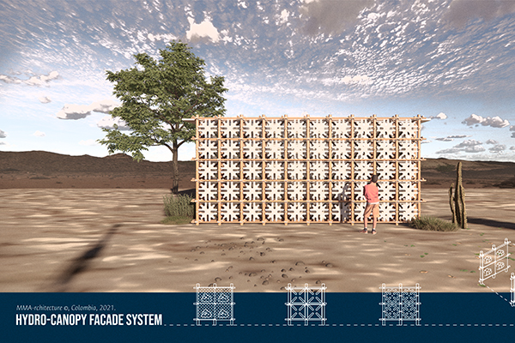
A1.Hydro-Canopy Facade System (Prototype)
Project Name: Hydro-Canopy Facade System
SDG: 9. Industry Innovation and Infrastructure, 13. Climate Action
Locations: Colombia
Programs: Global Design Challenge
Years: 2021
Find out more!
Retrieved November 8, 2021, from https://biomimicry.org/solutions/.

Slide 8
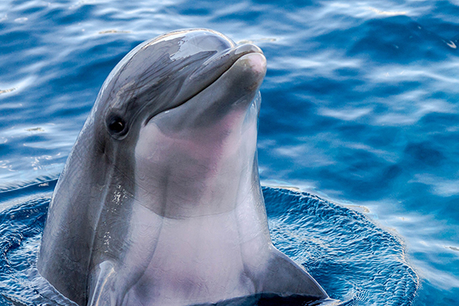
B1.Zooza: Cooler Communities
Zooza is a cooling strategy inspired by a couple organisms’ abilities to change color in response to UV rays; the microstructure of the white scarab beetle, which scatters light of all wavelengths, creating a brilliant white to keep cool; and the bottlenose dolphins’ peer-to-peer information-sharing network.
Energy
9/10
Optimize
7/10
Recycling
6/10
Materials
8/10
Cooperation
4/10
Information
5/10
Retrieved November 8, 2021, from https://biomimicry.org/solutions/.

Slide 9
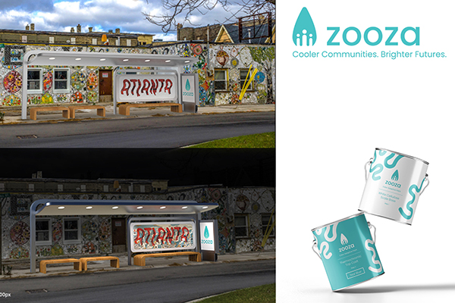
B1.Zooza: Cooler Communities (Prototype)
Project Name: Zooza: Cooler Communities. Brighter Futures
SDG: 3. Good Health and Well-being, 11. Sustainable Cities and Communities, 13. Climate Action
Locations: United States
Programs: Global Design Challenge
Years: 2021
Find out more!
Retrieved November 8, 2021, from https://biomimicry.org/solutions/.

Slide 10
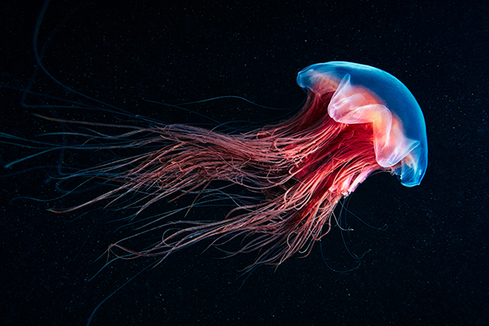
C1.Full Circle
Georgia Tech wanted to find a more resilient way to produce clean renewable electricity from underwater sea currents. The design was informed by the bell-shaped body of jellyfish, how schools of fish position themselves, how heart valves move liquid, and how kelp blades are adapted to rapidly flowing water and maximize photosynthesis.
Energy
8/10
Optimize
5/10
Recycling
2/10
Materials
2/10
Cooperation
6/10
Information
2/10
Retrieved November 8, 2021, from https://biomimicry.org/solutions/.

Slide 11
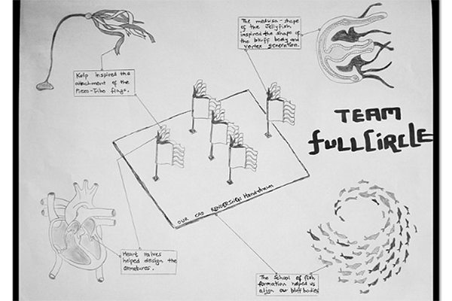
C1.Full Circle (Prototype)
Project Name: Full Circle
SDG: 7. Affordable and Clean Energy, 9. Industry Innovation and Infrastructure, 11. Sustainable Cities and Communities, 12. Responsible Consumption and Production, 13. Climate Action
Locations: United States
Programs: Global Design Challenge,
Launchpad
Years: 2019
Find out more!
Retrieved November 8, 2021, from https://biomimicry.org/solutions/.

Slide 12
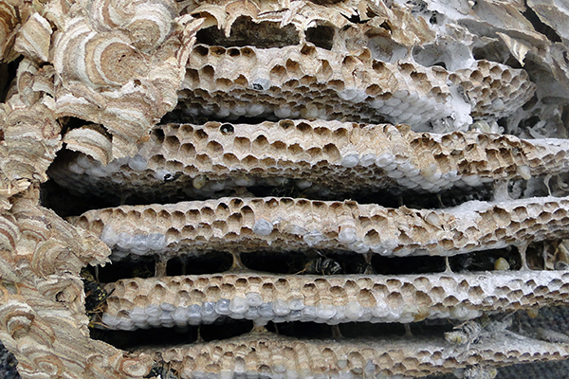
D1.Tidal Twister
The Tidal Twister seeks to address coastline erosion. Inspired by mangroves, spiral horned antelope, and mud dauber wasps, the team proposed a 3D printed cement spiral anchored to the coastal seabed where it reduces wave energy and creates habitat for beneficial aquatic organisms found at varied depths.
Energy
2/10
Optimize
9/10
Recycling
7/10
Materials
10/10
Cooperation
6/10
Information
9/10
Retrieved November 8, 2021, from https://biomimicry.org/solutions/.

Slide 13
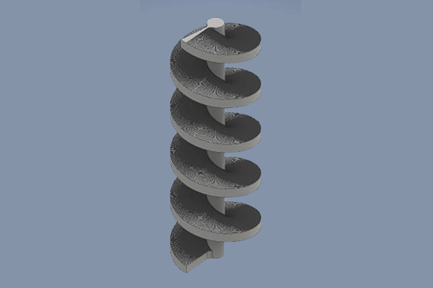
D1.Tidal Twister (Prototype)
Project Name: Tidal Twister
SDG: 13. Climate Action
Locations: United States
Programs: Youth Design Challenge
Years: 2021
Find out more!
Retrieved November 8, 2021, from https://biomimicry.org/solutions/.

Slide 14
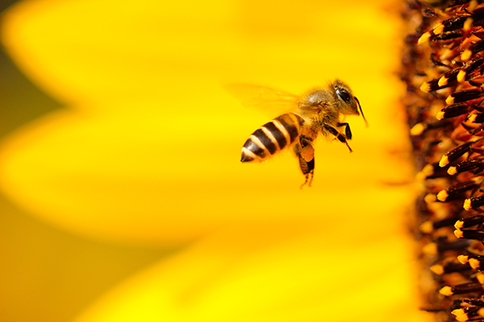
E1.Foothills Flow
Team Foothills Flow designed a nature-inspired mask that could be worn outside on these smoky days. They looked to the particle-trapping strategies of bees, mammalian eyelashes and nose hairs, and flower stigmas to design a surface that can capture small smoke particulates.
Energy
2/10
Optimize
7/10
Recycling
9/10
Materials
10/10
Cooperation
9/10
Information
5/10
Retrieved November 8, 2021, from https://biomimicry.org/solutions/.

Slide 15
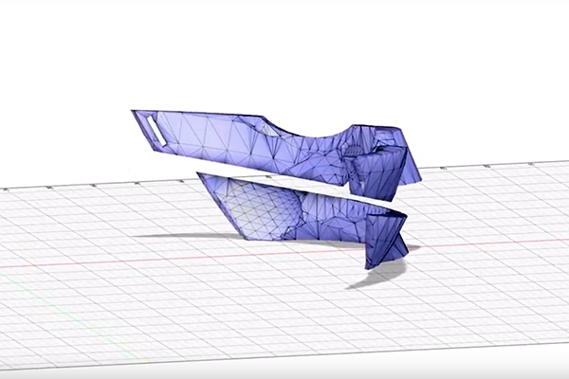
E1.Foothills Flow (Prototype)
Project Name: Foothills Flow
SDG: 15. Life On Land
Locations: Canada
Programs: Launchpad
Years: 2019
Find out more!
Retrieved November 8, 2021, from https://biomimicry.org/solutions/.

Slide 16
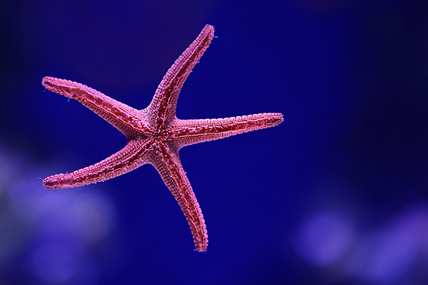
F1.BioBRICKery
The BioBRICKery team sought to address climate-related housing displacement and carbon dioxide emissions from the building industry. They created and tested a prototype for a carbon-sequestering mud brick that is inspired by calcium carbonate-producing marine organisms, the use of hexagons for strength found in multiple organisms, and a freeze-resistant arctic fish.
Energy
7/10
Optimize
6/10
Recycling
10/10
Materials
10/10
Cooperation
5/10
Information
9/10
Retrieved November 8, 2021, from https://biomimicry.org/solutions/.

Slide 17
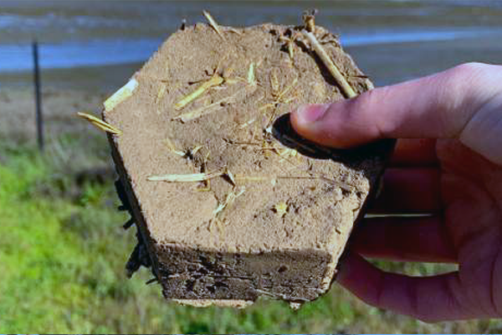
F2.BioBRICKery (Prototype)
Project Name: BioBRICKery
SDG: 13. Climate Action
Locations: United States
Programs: Youth Design Challenge
Years: 2021
Find out more!
Retrieved November 8, 2021, from https://biomimicry.org/solutions/.

Slide 18
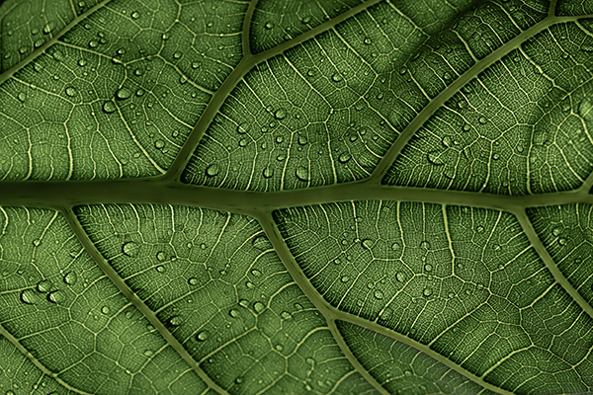
A2.New Iridium
New Iridium has created a suite of organic chemicals that enable photocatalysis, or light-driven chemistry, eliminating the need for heavy metals or heat as catalysts. New Iridium reduces the energy and time required for a wide variety of chemical reactions, lowering costs and paving the way for green chemistry.
Energy
10/10
Optimize
6/10
Recycling
5/10
Materials
10/10
Cooperation
9/10
Information
10/10
Retrieved November 8, 2021, from https://biomimicry.org/solutions/.

Slide 19
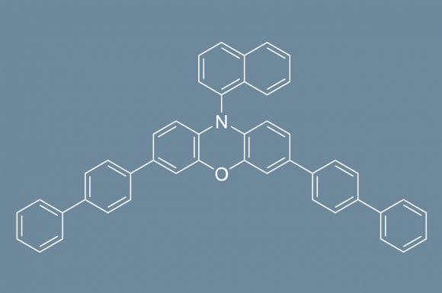
A2.New Iridium (Prototype)
Project Name: New Iridium
SDG: 7. Affordable and Clean Energy, 12. Responsible Consumption and Production, 13. Climate Action
Locations: United States
Programs: Ray of Hope Prize
Years: 2021
Find out more!
Retrieved November 8, 2021, from https://biomimicry.org/solutions/.

Slide 20
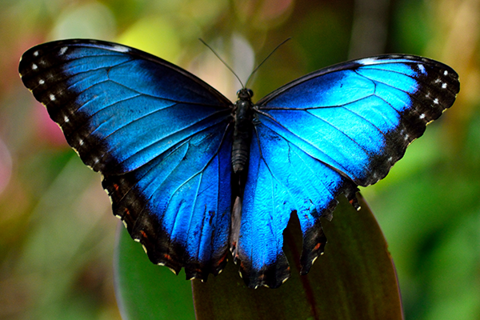
B2.MorphoBrick
The MorphoBrick is a building material concept, inspired by the Morpho butterfly, that changes its color and reflectivity in response to temperature. Their design allows buildings to regulate their temperatures efficiently by either absorbing or reflecting solar radiation inspired by the nanostructures found on Morpho butterfly wings.
Energy
9/10
Optimize
5/10
Recycling
8/10
Materials
10/10
Cooperation
3/10
Information
9/10
Retrieved November 8, 2021, from https://biomimicry.org/solutions/.

Slide 21
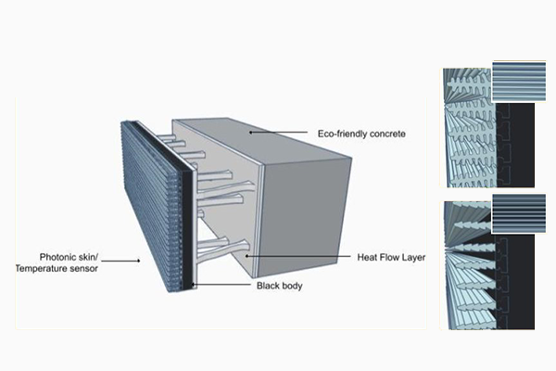
B2.MorphoBrick (Prototype)
Project Name: MorphoBrick
SDG: 13. Climate Action
Locations: United States
Programs: Youth Design Challenge
Years: 2021
Find out more!
Retrieved November 8, 2021, from https://biomimicry.org/solutions/.

Slide 22
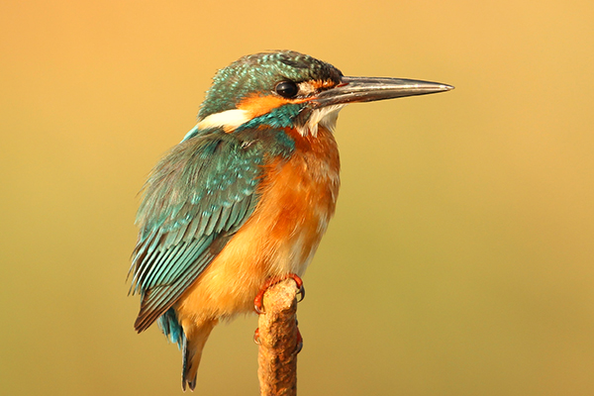
C2.Soil Erosion by Nature
The SSE team worked to develop a way to combat soil erosion problems. Their approach is inspired by the kingfisher’s “third eyelid”—a protective, retractable layer that covers the bird’s eyes while it plunges into water. Their device is a mesh structure that covers soil while it is submerged and flushed with water ensuring that it will not affect plant growth and damage the ecosystem.
Energy
2/10
Optimize
8/10
Recycling
3/10
Materials
7/10
Cooperation
5/10
Information
8/10
Retrieved November 8, 2021, from https://biomimicry.org/solutions/.

Slide 23
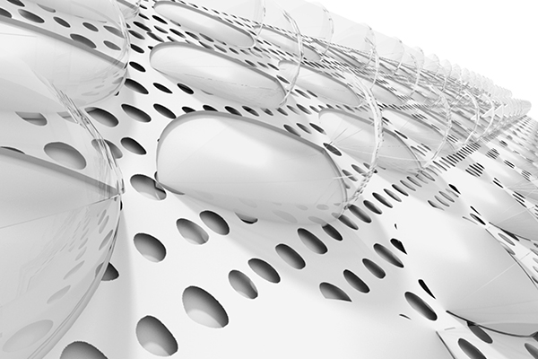
C2.Soil Erosion by Nature
(Prototype)
Project Name: Soil Erosion by Nature
SDG: 9. Industry Innovation and Infrastructure, 13. Climate Action, 15. Life On Land
Locations: China
Programs: Global Design Challenge,
Launchpad
Years: 2018, 2019
Find out more!
Retrieved November 8, 2021, from https://biomimicry.org/solutions/.

Slide 24
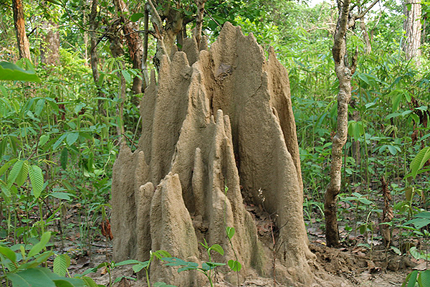
D2.Phalanx Insulation
An insulation grid that is applied to exterior walls of existing buildings to reduce interior temperatures of buildings passively. Intended to be used in urban coastal regions, Phalanx is a panel system that you construct onto the walls of buildings that get hot due to direct sunlight. Phalanx helps cool down the walls of buildings to keep the interior temperature cool and temperate.
Energy
10/10
Optimize
9/10
Recycling
8/10
Materials
8/10
Cooperation
6/10
Information
10/10
Retrieved November 8, 2021, from https://biomimicry.org/solutions/.

Slide 25
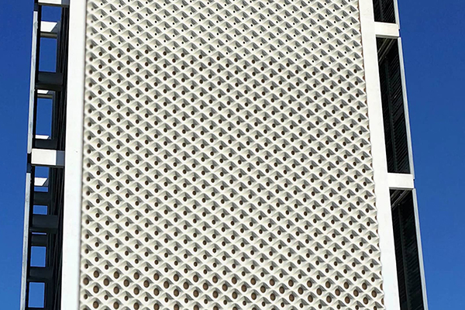
D2.Phalanx Insulation
(Prototype)
Project Name: Phalanx Insulation
SDG: 9. Industry Innovation and Infrastructure, 11. Sustainable Cities and Communities, 12. Responsible Consumption and Production, 13. Climate Action
Locations: United States
Programs: Global Design Challenge,
Launchpad
Years: 2019
Find out more!
Retrieved November 8, 2021, from https://biomimicry.org/solutions/.

Slide 26
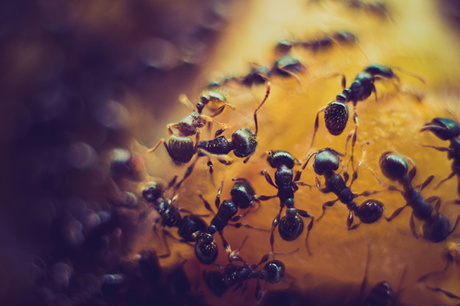
E2.Slant
Slant is an app that mimics the way ants communicate with each other both through one-on-one interactions and through pheromone trails. This app aims to reduce food waste by creating a platform for users to influence each other’s decisions regarding the quality and location of food..
Energy
2/10
Optimize
10/10
Recycling
1/10
Materials
2/10
Cooperation
6/10
Information
10/10
Retrieved November 8, 2021, from https://biomimicry.org/solutions/.

Slide 27
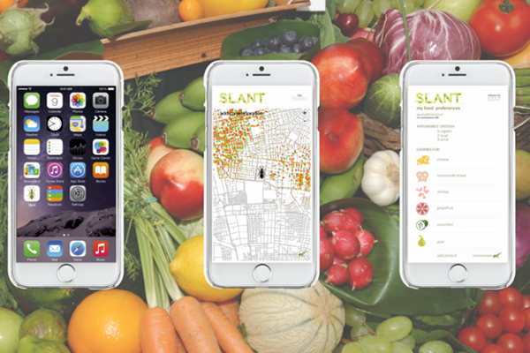
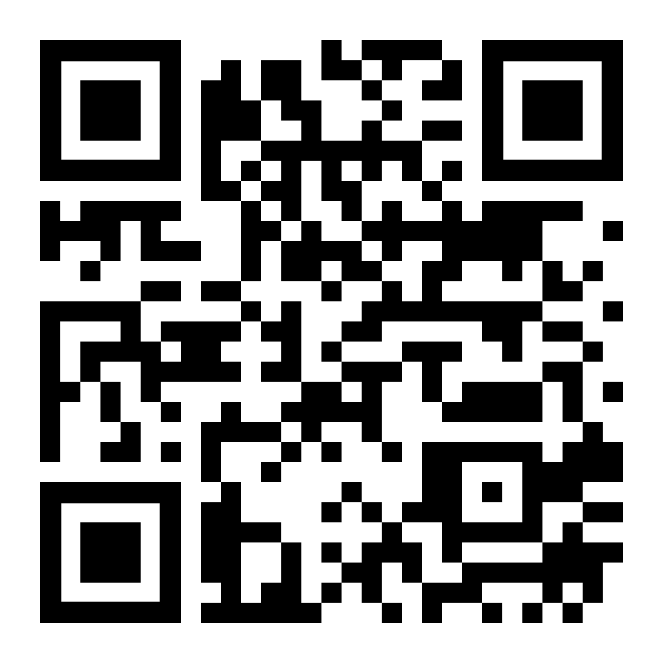
E2.Slant (Prototype)
Project Name: Slant
SDG: 2. Zero Hunger, 11. Sustainable Cities and Communities, 12. Responsible Consumption and Production, 13. Climate Action
Locations: Chile
Programs: Global Design Challenge,
Launchpad
Years: 2017
Find out more!
Retrieved November 8, 2021, from https://biomimicry.org/solutions/.

Slide 28
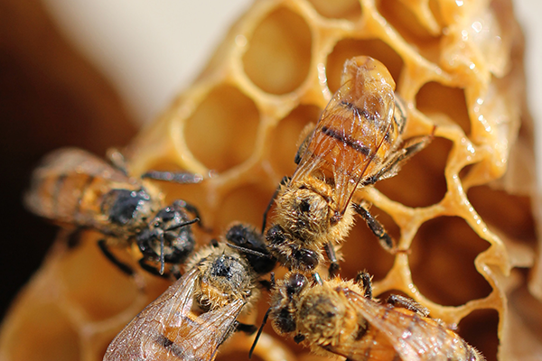
F2.Hexagro
Team Hexagro has created a “groundless” growing system that gives people the opportunity to grow healthy food on a small footprint. Hydroponic systems often use synthetic materials and tend to work as closed systems. In comparison, Hexagro is made of recyclable, biodegradable materials and has a unique, hexagonal shape that was inspired by geometric patterns found in nature.
Energy
5/10
Optimize
10/10
Recycling
7/10
Materials
9/10
Cooperation
9/10
Information
9/10
Retrieved November 8, 2021, from https://biomimicry.org/solutions/.

Slide 29
F2.Hexagro (Prototype)
Project Name: Hexagro
SDG: 2. Zero Hunger, 3. Good Health and Well-being, 8. Decent Work and Economic Growth, 11. Sustainable Cities and Communities, 12. Responsible Consumption and Production, 13. Climate Action
Locations: Colombia, Costa Rica, Italy
Programs: Global Design Challenge,
Launchpad
Years: 2016
Find out more!
Retrieved November 8, 2021, from https://biomimicry.org/solutions/.

Slide 30
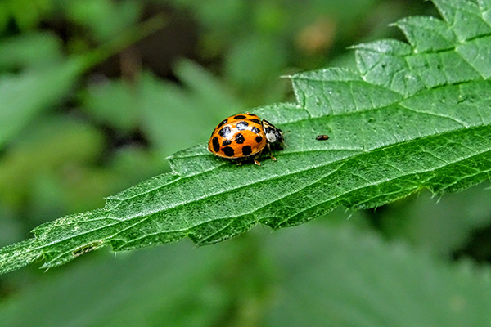
A3.Elightra
Powered by solar panels that are protected by hard outer shells like a ladybug’s elytra, or wing cases, ELIGHTRA is an environmentally-friendly lighting solution that helps build resilient communities. This innovative, community-focused solution provides light and energy to refugees living in “temporary” camps, bringing displaced peoples together within temporary settlements..
Energy
10/10
Optimize
8/10
Recycling
6/10
Materials
6/10
Cooperation
4/10
Information
5/10
Retrieved November 8, 2021, from https://biomimicry.org/solutions/.

Slide 31
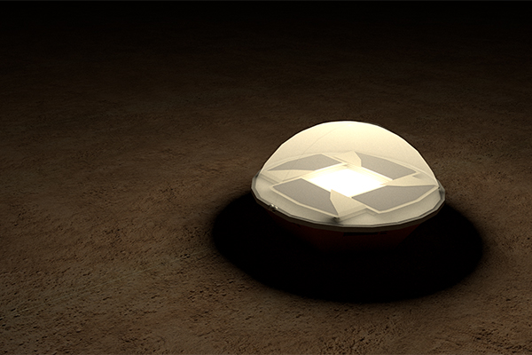
A3.Elightra (Prototype)
Project Name: ELIGHTRA
SDG: 3. Good Health and Well-being, 4. Quality Education, 5. Gender Equality, 7. Affordable and Clean Energy, 16. Peace Justice and Strong Institutions
Locations: United States
Programs: Global Design Challenge
Years: 2020
Find out more!
Retrieved November 8, 2021, from https://biomimicry.org/solutions/.

Slide 32
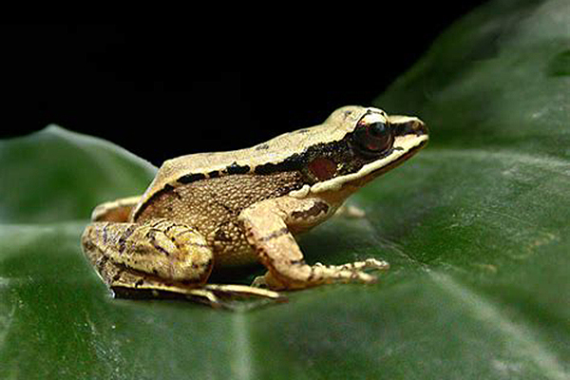
B3.A Sensitive Wall
Inspired by concave-eared torrent frogs, mimosa leaves and desert snails, one team in Taiwan designed a green noise barrier and sunshade system (Sensitive Wall) that aims to improve urban living conditions by providing a dynamic natural sound proofing system and elevation greenery to urban landscapes.
Energy
6/10
Optimize
9/10
Recycling
5/10
Materials
9/10
Cooperation
10/10
Information
5/10
Retrieved November 8, 2021, from https://biomimicry.org/solutions/.

Slide 33
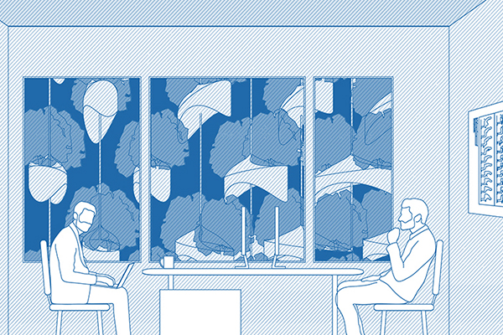
B3.A Sensitive Wall
(Prototype)
Project Name: A Sensitive Wall
SDG: 3. Good Health and Well-being, 9. Industry Innovation and Infrastructure, 11. Sustainable Cities and Communities, 13. Climate Action
Locations: Taiwan
Programs: Global Design
Challenge
Years: 2020
Find out more!
Retrieved November 8, 2021, from https://biomimicry.org/solutions/.

Slide 34
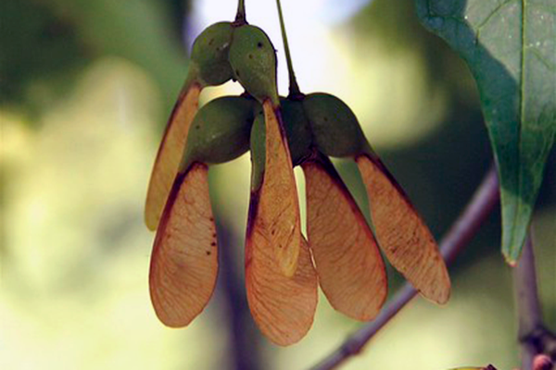
C3.Project RED
This team chose to address the problem of deforestation by designing a method to make it easier to replant trees over large areas. Project RED proposes a maple seed inspired seed-carrier that could be released from airplanes to then float to the ground on wing-like propellers. Made out of a water-soluble paper, the device would rapidly biodegrade as the tree seedling begins to grow.
Energy
4/10
Optimize
8/10
Recycling
10/10
Materials
9/10
Cooperation
3/10
Information
7/10
Retrieved November 8, 2021, from https://biomimicry.org/solutions/.

Slide 35
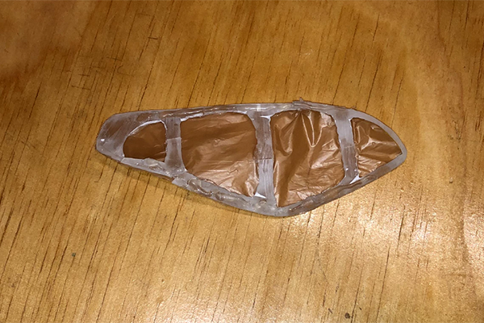
C3.Project RED
(Prototype)
Project Name: Project RED
SDG: 13. Climate Action
Locations: United States
Programs: Youth Design Challenge
Years: 2021
Find out more!
Retrieved November 8, 2021, from https://biomimicry.org/solutions/.

Slide 36
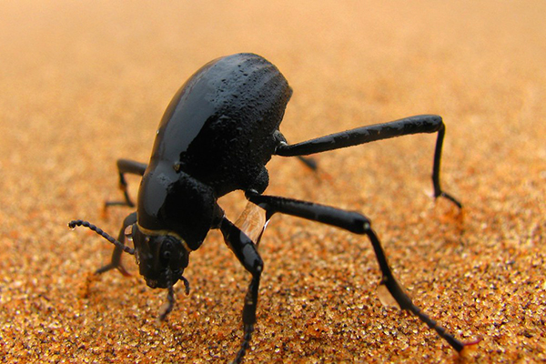
D3.Fog Collection
People of the Atacama Desert have come up with ways to collect water out of thin air. Air2Water is a roofing tile that harvests fog from thin air. Slanted grooves on the base of the metal tile will lead the water into a series of pipes where it can be used. The team have also incorporated some of the methods used by people living the Atacama Desert, such as mesh material that dew collects on.
Energy
2/10
Optimize
9/10
Recycling
10/10
Materials
8/10
Cooperation
4/10
Information
9/10
Retrieved November 8, 2021, from https://biomimicry.org/solutions/.

Slide 37
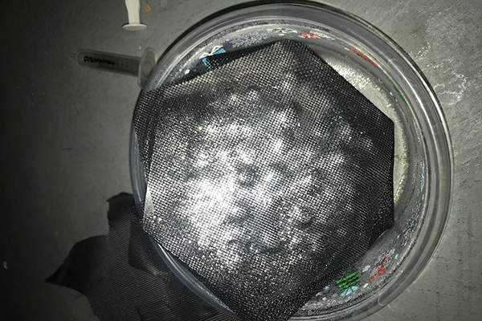
D3.Fog Collection
(Prototype)
Project Name: Fog Collection
SDG: 13. Climate Action
Locations: United States
Programs: Youth Design Challenge
Years: 2019
Find out more!
Retrieved November 8, 2021, from https://biomimicry.org/solutions/.

Slide 38
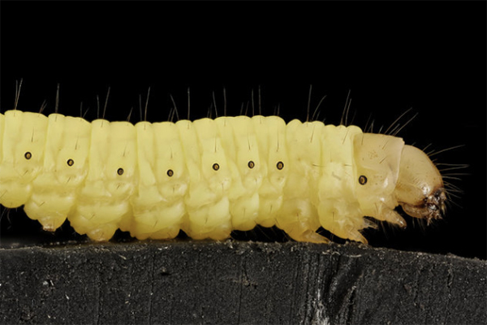
E3.MOL
Wax moth caterpillars can eat plastic, leading to interesting sustainability applications. The MOL team is looking to selectively breed wax moth caterpillars to become more efficient plastic decomposers. Additionally, the team of scientists are studying the enzymes that allow the larvae to break down the plastic, and they aim to artificially synthesize the compound for use in chemical recycling.
Energy
9/10
Optimize
4/10
Recycling
10/10
Materials
8/10
Cooperation
7/10
Information
3/10
Retrieved November 8, 2021, from https://biomimicry.org/solutions/.

Slide 39
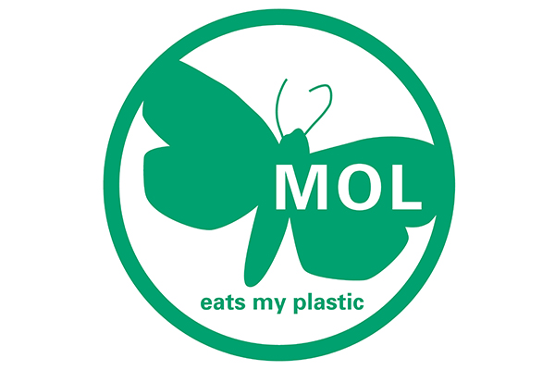
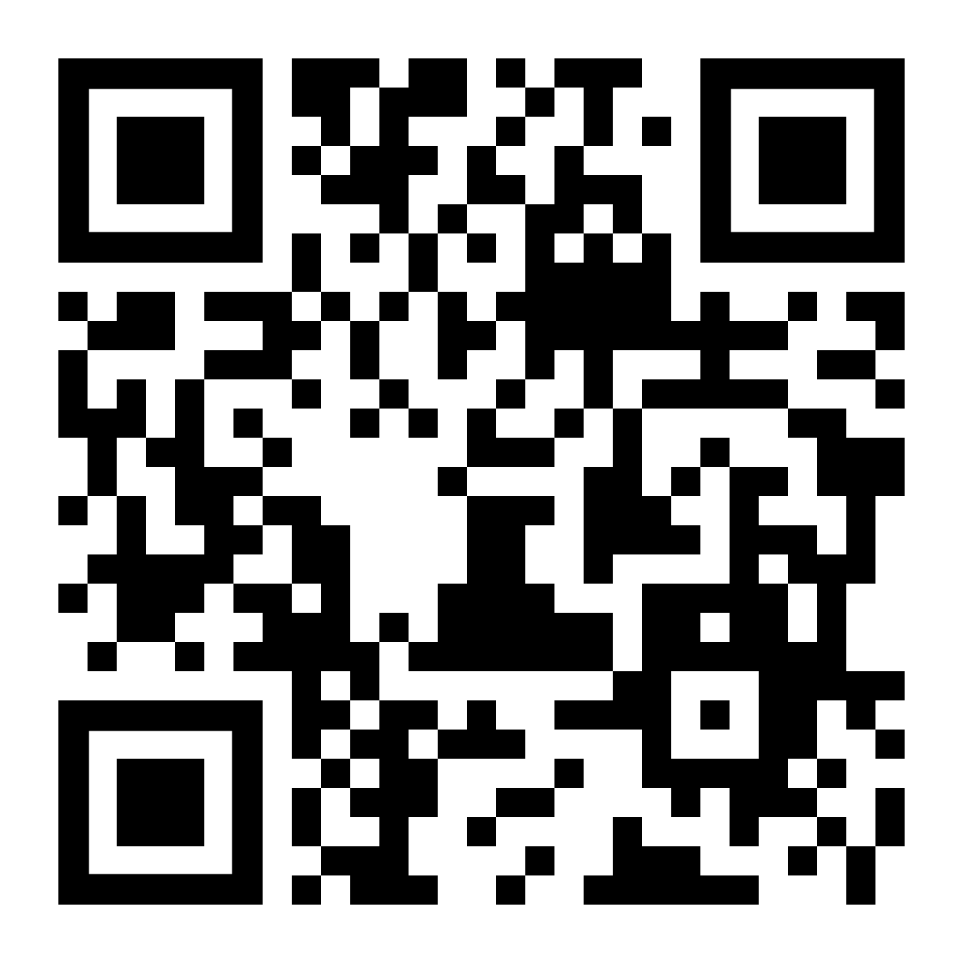
E3.MOL (Prototype)
Project Name: MOL
SDG: 9. Industry Innovation and Infrastructure, 11. Sustainable Cities and Communities, 12. Responsible Consumption and Production, 14. Life Below Water, 15. Life On Land
Locations: Ukraine
Programs: Global Design Challenge
Years: 2021
Find out more!
Retrieved November 8, 2021, from https://biomimicry.org/solutions/.

Slide 40
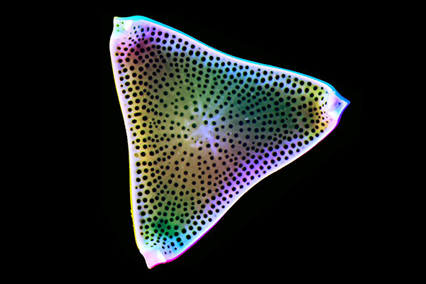
F3.Aquammodate
Aquammodate is mimicking the way diatoms form their cell wall out of silica and utilizing aquaporins, proteins that transport pure water across cell membranes throughout nature. Their energy-efficient and selective technology produces high purity grade water in a single filter pass, desalination at any scale, and removes industrial pollutants and contaminants such as arsenic, microplastics, and pharmaceutical residues.
Energy
9/10
Optimize
7/10
Recycling
6/10
Materials
9/10
Cooperation
9/10
Information
8/10
Retrieved November 8, 2021, from https://biomimicry.org/solutions/.

Slide 41
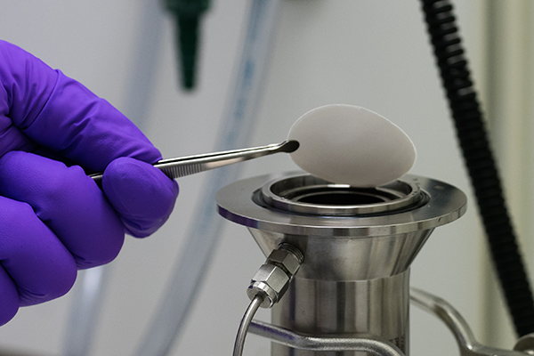
F3.Aquammodate (Prototype)
Project Name: Aquammodate
SDG: 6. Clean Water and Sanitation, 9. Industry Innovation and Infrastructure, 14. Life Below Water
Locations: Sweden
Programs: Ray of Hope Prize
Years: 2021
Find out more!
Retrieved November 8, 2021, from https://biomimicry.org/solutions/.

Slide 42
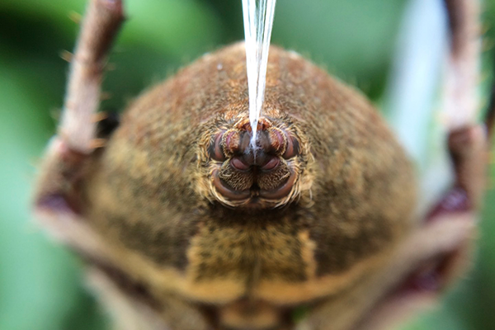
A4.Spintex Engineering
Spider silk is often cited as one of the strongest biological materials in the world. Spintex Engineering has finally cracked the spider’s code and has developed a solution that mimics a spider spinnerets’ ability to spin fiber at room temperature without harsh chemicals, from a liquid gel. Their process is 1,000 times more energy efficient than synthetic, petroleum fibers, with water as their only by-product.
Energy
4/10
Optimize
10/10
Recycling
6/10
Materials
10/10
Cooperation
5/10
Information
9/10
Retrieved November 8, 2021, from https://biomimicry.org/solutions/.

Slide 43
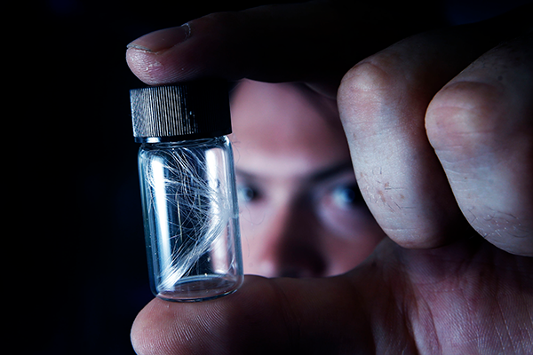
A4.Spintex Engineering (Prototype)
Project Name: Spintex Engineering
SDG: 9. Industry Innovation and Infrastructure, 12. Responsible Consumption and Production, 13. Climate Action
Locations: United Kingdom
Programs: Ray of Hope Prize
Years: 2021
Find out more!
Retrieved November 8, 2021, from https://biomimicry.org/solutions/.

Slide 44
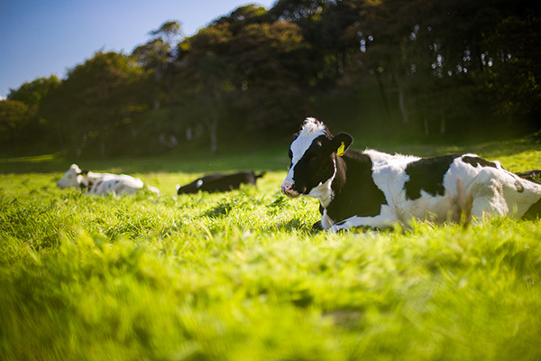
B4.EcoStp
EcoStp is a low-maintenance technology producing energy instead of consuming it, compared to conventional STPs which use energy-hogging motors, exhaust fans, pumps and blowers. This design doesn’t use chemicals to treat the sewage, but instead uses microorganisms, plants, and gravel to treat wastewater (1 million liters of sewage a day).
Energy
10/10
Optimize
7/10
Recycling
10/10
Materials
4/10
Cooperation
8/10
Information
8/10
Retrieved November 8, 2021, from https://biomimicry.org/solutions/.

Slide 45
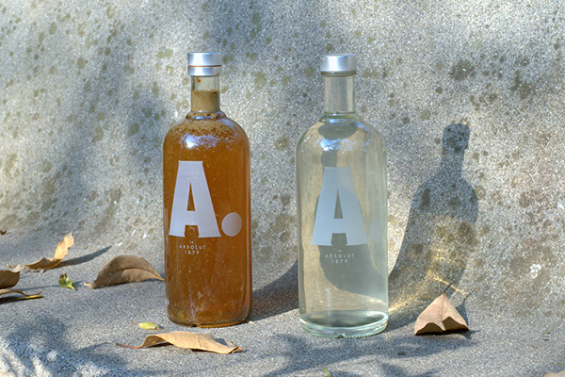
B4.EcoStp
(Prototype)
Project Name: EcoStp
SDG: 3. Good Health and Well-being, 6. Clean Water and Sanitation, 8. Decent Work and Economic Growth, 9. Industry Innovation and Infrastructure, 11. Sustainable Cities and Communities, 12. Responsible Consumption and Production, 13. Climate Action, 15. Life On Land
Locations: India
Programs: Global Design Challenge,
Launchpad
Years: 2019, 2018
Find out more!
Retrieved November 8, 2021, from https://biomimicry.org/solutions/.

Slide 46
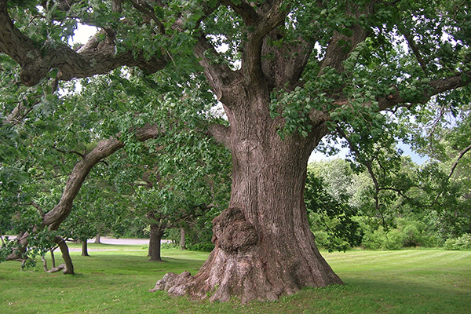
C4.MyOak Public Market
In response to the COVID-19 pandemic, the team that created MyOak Public Market asked “How might we cultivate a more connected and responsive food system network to ensure food access during times of crisis?” Inspired by the Chesapeake Forest in their own backyard, they designed a reciprocal online platform to increase food access for vulnerable populations as well as the economic potential of local food producers.
Energy
4/10
Optimize
10/10
Recycling
3/10
Materials
3/10
Cooperation
10/10
Information
7/10
Retrieved November 8, 2021, from https://biomimicry.org/solutions/.

Slide 47
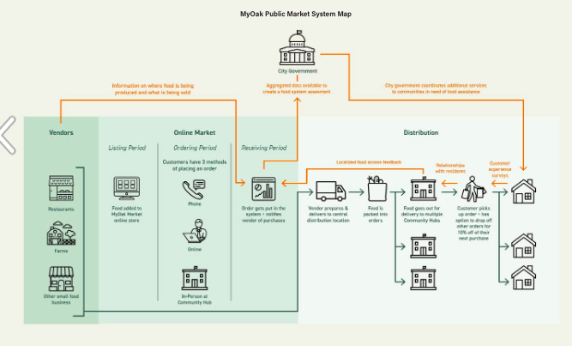
C4.MyOak Public Market
(Prototype)
Project Name: MyOak Public Market
SDG: 2. Zero Hunger, 8. Decent Work and Economic Growth, 10. Reduced Inequalities, 11. Sustainable Cities and Communities
Locations: United States
Programs: Global Design Challenge
Years: 2020
Find out more!
Retrieved November 8, 2021, from https://biomimicry.org/solutions/.

Slide 48
D4.The Moist Brick
To solve for extreme changes in weather and provide a solution for natural cooling, Moist Brick was created as a building material that would condense water from nighttime air and collect it on the surface as an evaporative cooling system for buildings. The team was inspired by the hydrophilic hairs on the surface of some plants and the Texas Horned Lizard, which uses capillary action to move water from anywhere on its skin to its mouth.
Energy
9/10
Optimize
9/10
Recycling
5/10
Materials
10/10
Cooperation
4/10
Information
7/10
Retrieved November 8, 2021, from https://biomimicry.org/solutions/.

Slide 49
D4.The Moist Brick
(Prototype)
Project Name: The Moist Brick
SDG: 13. Climate Action
Locations: United States
Programs: Youth Design Challenge
Years: 2020
Find out more!
Retrieved November 8, 2021, from https://biomimicry.org/solutions/.

Slide 50
E4.Jube
Edible insects may be one of the answers to our global food crisis. Jube is a bio-inspired chamber for capturing edible insects inspired by carnivorous plants. This device promotes a more sustainable way to incorporate protein and nutrients into the world’s diet by offering an insect-capturing device that is unique and beautifully crafted.
Energy
2/10
Optimize
7/10
Recycling
4/10
Materials
8/10
Cooperation
5/10
Information
9/10
Retrieved November 8, 2021, from https://biomimicry.org/solutions/.

Slide 51
E4.Jube (Prototype)
Project Name: Jube
SDG: 1. No Poverty, 2. Zero Hunger, 3. Good Health and Well-being, 8. Decent Work and Economic Growth, 12. Responsible Consumption and Production, 13. Climate Action, 15. Life On Land
Locations: Thailand
Programs: Global Design Challenge,
Launchpad
Years: 2016
Find out more!
Retrieved November 8, 2021, from https://biomimicry.org/solutions/.

Slide 52
F4.BottleBricks
BottleBricks was designed to address the growing problem of lack of adequate housing for refugees in camps. Mimicking the triangular corrugated shape of Saharan silver ant hairs and still air trapped within silk cocoons, along with the interlocking structure of nacre (mother of pearl), this interlocking bottle system that can be used to improve existing shelters to better protect against cold, warm, and wet weather conditions.
Energy
10/10
Optimize
6/10
Recycling
6/10
Materials
9/10
Cooperation
5/10
Information
6/10
Retrieved November 8, 2021, from https://biomimicry.org/solutions/.

Slide 53
F4.BottleBricks (Prototype)
Project Name: BottleBricks
SDG: 3. Good Health and Well-being, 12. Responsible Consumption and Production, 17. Partnerships for the Goals
Locations: Netherlands
Programs: Global Design Challenge
Years: 2020
Find out more!
Retrieved November 8, 2021, from https://biomimicry.org/solutions/.

Slide 54
A5.Velcro (Hooked on You!)
Lesser burdock served as the inspiration and model for the invention of Velcro, which reproduces the attachment strategy by using two strips of fabric: one which resembles the spines with curved hooks, and one which resembles animal fur with thousands of tiny loops. When the two fabrics meet, they adhere to each other in a secure but removable manner, allowing them to be reused.
Energy
1/10
Optimize
8/10
Recycling
7/10
Materials
10/10
Cooperation
1/10
Information
8/10
Retrieved November 8, 2021, from https://biomimicry.org/solutions/.

Slide 55
A5.Velcro (Hooked on You!)
(Prototype)
Project Name: Velcro
Goal 12: Responsible Production &
Consumption
Locations: Switzerland
Programs: Velcro SA Company
Years: 1955
Find out more!
Innovation inspired by nature - asknature. Innovation Inspired by Nature -. (n.d.). Retrieved December 1, 2021, from https://asknature.org/.
Stock images - photos, vectors &amp; Illustrations for Creative Projects. Shutterstock. (n.d.). Retrieved December 1, 2021, from https://www.shutterstock.com/.

Slide 56
B5.PowerCone
The blades of modern wind turbines have poor
aerodynamic properties at the blade root. Through its refined geometry, inspired by the flow path of a falling maple seed, the PowerCone equalizes the pressure distribution across the entire rotor disk and reduces the impact of gusts, boosting performance for the whole turbine while reducing loads on the rotor.
Energy
10/10
Optimize
10/10
Recycling
5/10
Materials
4/10
Cooperation
9/10
Information
8/10
Retrieved November 8, 2021, from https://biomimicry.org/solutions/.

Slide 57
B5.PowerCone (Prototype)
Project Name: PowerCone
SDG: 9. Industry Innovation and Infrastructure, 11. Sustainable Cities and Communities,
13. Climate Action,
Locations: Canada
Programs: Biome - Renewables
Years: 2020
Find out more!
Powercone. Biome Renewables. (n.d.). Retrieved December 1, 2021, from https://www.biome-renewables.com/powercone.
Stock images - photos, vectors &amp; Illustrations for Creative Projects. Shutterstock. (n.d.). Retrieved December 1, 2021, from https://www.shutterstock.com/.

Slide 58
C5. The Dome Home
Team Matinor incorporated inspiration from the multiple organisms to design a home that could withstand extreme weather in the Carribean — a region facing increasing risk from hurricanes due to climate change. The Dome Home mimics the dome shape of an ovenbird’s mud nest to withstand high winds, the deep tap root of the longleaf pine to anchor the foundation, and the unique structure of the woodpecker’s skull to absorb shock.
Energy
3/10
Optimize
9/10
Recycling
3/10
Materials
7/10
Cooperation
6/10
Information
4/10
Retrieved November 8, 2021, from https://biomimicry.org/solutions/.

Slide 59
C5.The Dome Home (Prototype)
Project Name: The Dome Home
SDG: 11. Sustainable Cities and Communities
Locations: United States
Programs: Youth Design Challenge
Years: 2020
Find out more!
Retrieved November 8, 2021, from https://biomimicry.org/solutions/.

Slide 60
D5.GeckSkin
The ability of geckos to climb vertical and overhanging walls has long fascinated scientists and laypeople alike. On their toepads, geckos possess millions of minute hairs called setae that act as a soft substrate that can conform to surfaces. Geckskin™ is a novel technology, inspired by Geckos, that is revolutionizing how we attach objects together.
Energy
1/10
Optimize
9/10
Recycling
8/10
Materials
10/10
Cooperation
3/10
Information
9/10
Retrieved November 8, 2021, from https://biomimicry.org/solutions/.

Slide 61
D5.GeckSkin (Prototype)
Project Name: Geckskin™
Goal 9: Industry Innovation & Infrastructure
Locations: United States
Programs: Advanced Materials
Journal
Years: 2012
Find out more!
Geckskin™ is a new super-adhesive based on the mechanics ... (n.d.). Retrieved December 1, 2021, from https://geckskin.umass.edu/.
Stock images - photos, vectors &amp; Illustrations for Creative Projects. Shutterstock. (n.d.). Retrieved December 1, 2021, from https://www.shutterstock.com/.

Slide 62
E5.Floating Coconet
Floating Coconet aims to capture plastic pollution in rivers before it has the chance to enter the oceans. By mimicking the way organisms like manta rays and basking sharks filter food from water, Floating Coconet of The Hague University of Applied Sciences in Hague, Netherlands, is able to collect and direct free-flowing plastics, small and large in size, in rivers for safer capture.
Energy
10/10
Optimize
8/10
Recycling
6/10
Materials
6/10
Cooperation
7/10
Information
9/10
Retrieved November 8, 2021, from https://biomimicry.org/solutions/.

Slide 63
E5.Floating Coconet (Prototype)
Project Name: Floating Coconet
SDG: 6. Clean Water and Sanitation, 13. Climate Action, 14. Life Below Water
Locations: Netherlands
Programs: Launchpad
Years: 2019
Find out more!
Retrieved November 8, 2021, from https://biomimicry.org/solutions/.

Slide 64
F5.nutriBarrier
nutriBarrier is designed to be deployed around crops to reduce this runoff while also ensuring a slow release of fertilizer. Made from materials inspired by the protective strategies of hagfish and frogs, this barrier can be woven around individual plants in a helix pattern, using materials economically while protecting and watering each plant.
Energy
4/10
Optimize
8/10
Recycling
7/10
Materials
9/10
Cooperation
10/10
Information
8/10
Retrieved November 8, 2021, from https://biomimicry.org/solutions/.

Slide 65
F5.nutriBarrier (Prototype)
Project Name: nutriBarrier
SDG: 1. No Poverty, 2. Zero Hunger, 3. Good Health and Well-being, 6. Clean Water and Sanitation, 8. Decent Work and Economic Growth, 12. Responsible Consumption and Production, 13. Climate Action, 14. Life Below Water, 15. Life On Land
Locations: Australia
Programs: Global Design Challenge
Years: 2020
Find out more!
Retrieved November 8, 2021, from https://biomimicry.org/solutions/.

Slide 66
Creator:
Dr. Loukas Katikas
(Ellinogermaniki Agogi)
http://innature-project.eu/
The European Commission support for the production of this publication does not constitute an endorsement of the contents, which reflects the views only of the authors, and the Commission cannot be held responsible for any use which may be made of the information contained therein.
(Project Nº.: 2019-1-PL01-KA201-065655)

